Slide 1

CQRS
Command Query Responsibility Segregation
By Max Vasilyev
@trailmax
http://tech.trailmax.info

Slide 2

Curiosity Rover, Sol 1065 (5th Aug 2015 in Earth Time)
Notes:
As a theme for this presentation I have picked Curiosity Mars Rover. I think it is pretty amazing that there is a robot on another planet many miles away - taking selfies.
Scientific work is also important.
Also Mars is cool – the only planet populated by robots.

Slide 3

Quick Introduction into CQS
Command-Query Separation is a principle
Separate your reads from your writes
“Functions should either do something or answer something, but not both”*
Commands are for writes
Queries are for reads
Code Sample 1 – Separate Reads From Writes
* “Clean Code” by Uncle Bob Martin, 2008
Notes:
CQS is not a typo. CQS is a Command Query Separation. This is a general principle in programming. And this is an underlying idea in CQRS
Most likely you are already doing this. It is a very good programming practice to do one thing at a time.
Doing both in one function leads to a confusion and bugs.
Code Sample 1 – Separate Reads From Writes

Slide 4

Queries
Queries can be run multiple times without side effects
Queries do not change state of the system
Commands
Commands are changing state of the system
Commands can initiate interaction of the system with other systems (send email, etc.)
Notes:
Since queries are not supposed to do any writing, they should not change the state of the system. And a query implemented in the spirit of CQS can be executed multiple times without any side effects (possibly performance can be affected but this is a separate matter).
Commands on the other hands can also be idempotent but do not have to be. Some commands can initiate interactions with external systems, like sending an email or executing external API commands.

Slide 5

CQRS
Command-Query Responsibility Segregation – a pattern
Pattern at the object granularity: different objects (classes) are handling commands and queries
CQS puts commands and queries into different methods within a type
CQRS puts commands and queries into different objects*
Code Sample 2 – Basic CQRS
* From http://cqrs.nu/Faq/command-query-responsibility-segregation
Notes:
CQRS is more a pattern rather than a principle. A pattern applicable to the object (classes) that are doing reading and writing. CQS places reads and writes into different methods of the same class. CQRS goes further with the separation and places read method into separate class from the write method.
In the first code sample if we are working with in-memory dictionary, it is of a little value to place read and write operations into separate classes.
However, if we are storing these attributes in an external Key-Value Store, it makes sense to extract each method into different classes as different approaches might be required.

Slide 6
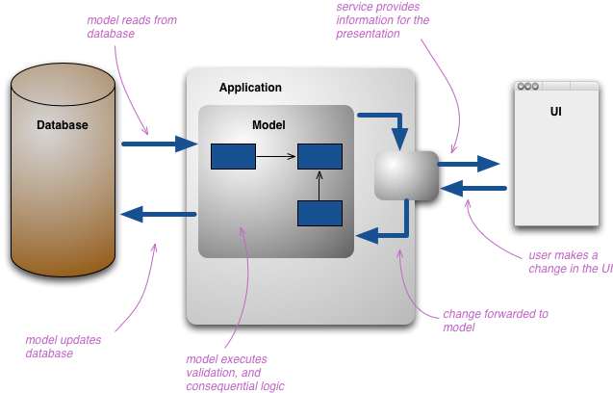
Typical CRUD Application
Image from http://martinfowler.com/bliki/CQRS.html
Notes:
User executes operations in UI, UI passes control to IPersonService or IProductService that does validation, writing and reading.
Application consists of a soup of repositories, services – reading, writing and validation is distributed between all these services

Slide 7
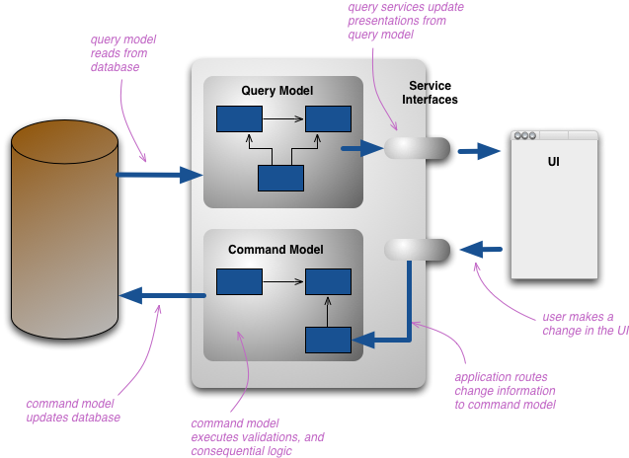
Same application with CQRS applied
Image from http://martinfowler.com/bliki/CQRS.html
Notes:
Queries are not mixed with commands

Slide 8

Model Separation in CQRS
Often CQRS means different storage mechanisms for reads and writes: write to one table, read from another database
This means that you need some process that does denormalisation from write model to a read-model
Data in read-model is somewhat stale
You don’t have to do this – this is optional
Notes:
Many articles will tell in order to get proper CQRS, you need to write to one model and read from another model. Here models can be tables, databases, servers, files – anything that can hold data. This means that you need to create some process that does data transformation from write-model into the read state.
Having a separate read-model means that it is not 100% up to date – the data is stale. But even if you read data from the same model as you write, the data becomes stale as soon as it is displayed to a user. So embrace it and accept that user will always see stale data, so there is no big issue!

Slide 9

Separate Read Model
Allows to scale read and write sides separately.
Usually denormalised data is for performance
Code Sample 3 – SQL Queries
Storage mechanisms can be different: it is easier to write to NoSQL, but SQL database is best for reporting*
Usually there's enough overlap between the command and query sides that sharing a model is easier
* See Reporting Database: http://martinfowler.com/bliki/ReportingDatabase.html
Notes:
Complex reports will highly benefit from separate read-models – see code sample. Which of the queries is going to be faster?
One of the examples is NoSQL and running reports. NoSQL (the ones I used) is pretty bad for complex reporting (either performance or API complexity).
But data from NoSQL can be denormalised into format suitable for reporting and stored in a RDB => Boom! Now we are having the best from the both worlds!
But beware. Adding a separate read model adds a lot more work and complexity. You need to think about eventual consistency, actor that does the denormalisation, etc.
Also separating the models allows to do different performance tuning for different operations. Usually there are more Reads than Writes. And with a single model you can optimise your system to do reads, but when occasional write operation comes in, everything stalls. Think of an index in a SQL Database. The more indexes on the table, the faster different queries are going to run. But the more indexes, the slower update commands are going to be executed because on update all these indexes need to be updated.

Slide 10

CQRS vs. DDD vs. Event Sourcing
All three go together very well
Event Sourcing can’t work (in most cases) without CQRS
Granular commands working well with task-based UI
Notes:
Event Sourcing is a technique when the information about a domain object is stored as a set of events: ProductCreated, ProductNameChanged, ProductDepricated, etc.
When an actor needs to see information about a product all the events are read in order and the full picture is restored.
Think of Git – every check-in is an event. The resulting source code on your machine is a snapshot – a read model if you like. Very much separation read and write models.
DDD is advocating to have your software designed around the business needs. Now think about commands CustomerChangedNameCommand or EmployeeChangeOfContractCommand. These are very much domain oriented. And every command usually matches a single screen on UI.

Slide 11

Refactoring Time: Repository vs Queries

Slide 12

SOLID: Queries
Queries and handlers are have very narrow responsibility
To modify one handler other classes are not affected
Easy to replace with a stub/mock for test
Interface segregation to an extreme – a single method
Dependencies are injected
Notes:
After the refactoring we have couples of classes that are highly specialized and have very narrow responsibility. Queries are passing parameters. QueryHandlers are processing these queries.
Each query is separated into a separate class and they are no longer coupled with each other. So if you want to change the storage for one single query – all other classes don’t care and are not affected.
Once we have introduced mediator abstraction layer, it is extremely easy to replace with a mock object for your tests.
Interfaces are extremely narrow – a single method – we are not forcing any unwanted interface method on the implementation or a client.
And all of those are only working when the dependencies are injected. This approach would not work without DI.

Slide 13

Enough of Mars!
Have a look on Pluto! →
Notes:
I think it is pretty! And pretty amazing to get this image.

Slide 14

Notes:
Taken on July 14, 2015, downloaded to Earth on 13th of Sept. Think about the connection speed!
This scene is about 780miles across. Length of UK is 874 miles. So this scene is slightly smaller than the UK. I can almost see Ben Nevis right here!
By the way, that white stuff you see is probably nitrogen snow drifts. It is so cold there, nitrogen freezes over and falls down as snow!

Slide 15


Slide 16

Refactoring Time: Commands vs Services

Slide 17

A lot of work, no gain! What is the point?
SOLID
Almost functional
Limited number of abstractions: 6 interfaces to cover most cases
Less dependencies for clients
Totally wrappable and replaceable!
Notes:
We have done a lot work to refactor our existing code into something that looks like more work to implement. But there are a lot of benefits to this code. Every single class implemented is sticking with principles of SOLID: narrow responsibility, to add functionality no need to modify the class. Handler interfaces have only a single method. If you are into a functional programming, this implementation can be translated into a function: a lot of handler functions with similar signature.
We have only 6 interfaces that cover most of the cases in the domain: limited number of abstractions lead to a cleaner code.
Consumers have only one dependency – Mediator.
Since there are only a handful of interfaces, now we can implement Decorator pattern with ease.

Slide 18

Separate Handlers
Handlers can be in other project
Handlers can be replaced at runtime
Useful for multi-tenancy applications and custom implementations
Can replace handlers based on application toggles
Easy to rewrite handlers
Can send commands/queries over a wire/put in a queue, etc.
Notes:
Because we are separating our commands (or queries) from their handler, we can have multiple implementations for handlers. And in different cases you can replace the handlers at runtime.
One of the examples is a multi-tenancy application that has custom implementations depending on a tenant: most of the tenants get default implementation, but tenants with own implementation get that substituted by DI container.
Also DI container will provide one or another handler depending on the toggle flags in your application configuration. This will save you a lot of extra if-statements

Slide 19

Decorator
Wraps around the executing class to add functionality
Useful to add Cross Cutting Concerns like security, logging, transactions, etc.
Powerful – can add a lot without changing consumers and handlers
Hard to add for multiple interfaces
Notes:
Decorator is also known as a Wrapper. And it is literally wrapping your code and does something extra in addition to what your code is already doing. The good thing is that decorator can be implemented without touching your actual code you would like to wrap. Also the consuming code stays the same – the magic happens in aggregate root where the objects are composed.
Because this is called a Wrapper, this pattern can be related to an actual plastic wrapper around some product you buy in a supermarket. Wrapper adds additional functionality – adding a handle so you can curry a box easier. Wrapper can add protection from damage. Wrapper can have some information printed on it and so on.
This pattern is very powerful as no changes are required for your code or consuming code. The only problem can be – if you have multiple interfaces (like ITrainingService you have seen earlier) it’ll be very tiresome to add the same wrapper around every interface in your system.

Slide 20

Decorator in CQRS
Decorator is easy to add in CQRS
Creating a pipeline of execution of commands or queries
Code Sample 5 – Decorator in CQRS
Great power of CQRS applied
Logging
Security
Error handling
Caching
Audit
Timing events
Retry logic
Transactions
A-B Testing
Ramping up new functionality
Notes:
CQRS has a limited number of interfaces thus making a decorator pattern very easy to implement, as you need only one class to wrap around all commands. And you are done – all your commands will have that code around them executed every time your commands are executed.
You can chain decorators together one inside the other, thus giving yourself a pipeline of execution for your commands or queries. And this is a great way to add Cross-Cutting concerns

Slide 21

References
Alternative implementation from Jimmy Bogard is MediatR https://github.com/jbogard/MediatR https://lostechies.com/jimmybogard/2015/05/05/cqrs-with-mediatr-and-automapper
All images are from http://photojournal.jpl.nasa.gov/ used with NASA’s implicit permission
Refactoring samples are inspired by Steven aka .Net Junkie: https://cuttingedge.it/blogs/steven/pivot/entry.php?id=92 https://cuttingedge.it/blogs/steven/pivot/entry.php?id=91
Martin Fowler: http://martinfowler.com/bliki/CQRS.html
Udi Dahan: https://skillsmatter.com/skillscasts/1250-udi-dahan-command-query-responsibility-segregation

Slide 22

Questions?
Code and slides available: https://github.com/trailmax/CQRS.Talk
Full implementation: https://github.com/AMVSoftware/CQRS

